Slide 1
S40: Is the world dividing into data realms and what does it mean for the nations outside the realms?
October 1st 2020 17h00 – 18h30

Slide 2
Patrick Leblond
October 1st 2020 17h00 – 18h30
University of Ottawa and CIGI
The EU and the Data Trilemma

Slide 3
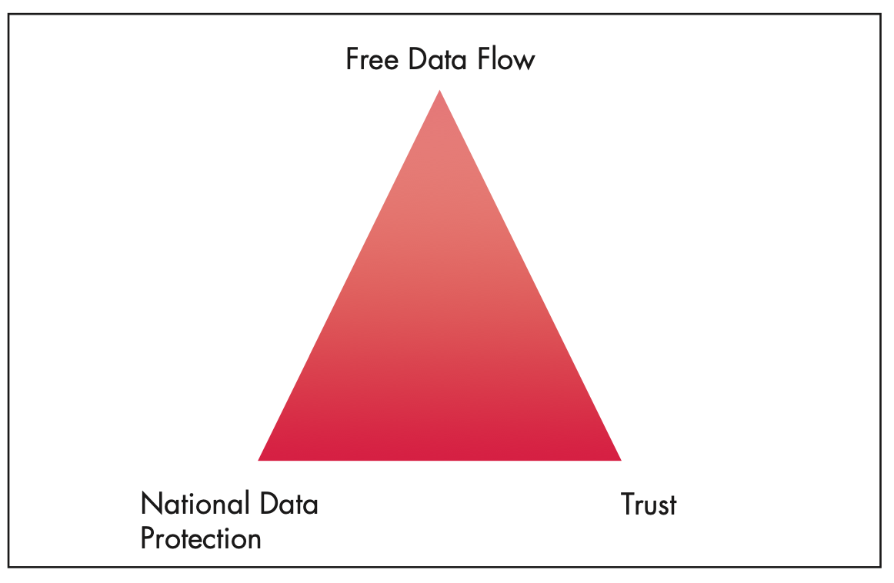
The Data Trilemma

Slide 4
How the EU Resolves the Data Trilemma (inside and outside its borders)
Data are free to flow within the EU
General Data Protection Regulation (GDPR) for personal data
Regulation on the free flow of non-personal data
Protecting data to create trust
GDPR
Non-personal data
Facilitate industry self-regulation (likely to change in the future)
Data flows between the EU and the rest of the world
GDPR “adequacy” (countrywide or specific organizations)
Data localization requirements allowed for non-personal data

Slide 5
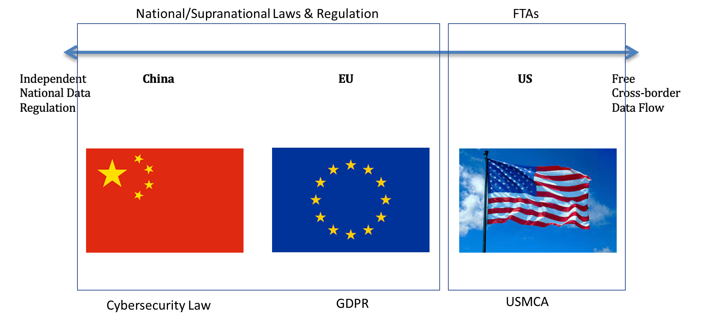
The EU’s Middle-Ground Approach

Slide 6
GDPR “Adequacy”: Extending the EU’s Realm
Only applies to personal data
Countries considered “adequate” by the European Commission
Andorra, Argentina, Canada, Faroe Islands, Guernsey, Israel, Isle of Man, Japan, Jersey, New Zealand, Switzerland and Uruguay
UK is adequate until the end of the of 2020
Uncertainty on post-Brexit economic partnership agreement
US is now in a no-person’s land
CJEU’s decision on the Privacy Shield

Slide 7
Going Beyond Data Regulation to Build Trust
Regulation of content on social media platforms
Licenses for copyrighted material
Fines for failure to remove hate speech and other illegal content, indlucing disinformation
Digital Services Act package
Competition (anti-trust) policy
One possible “market-based” solution for the EU to extend its realm : Digital consumption visas for non-EU individuals
EU data protection for people located outside the EU

Slide 8
Thank you!

