Slide 1
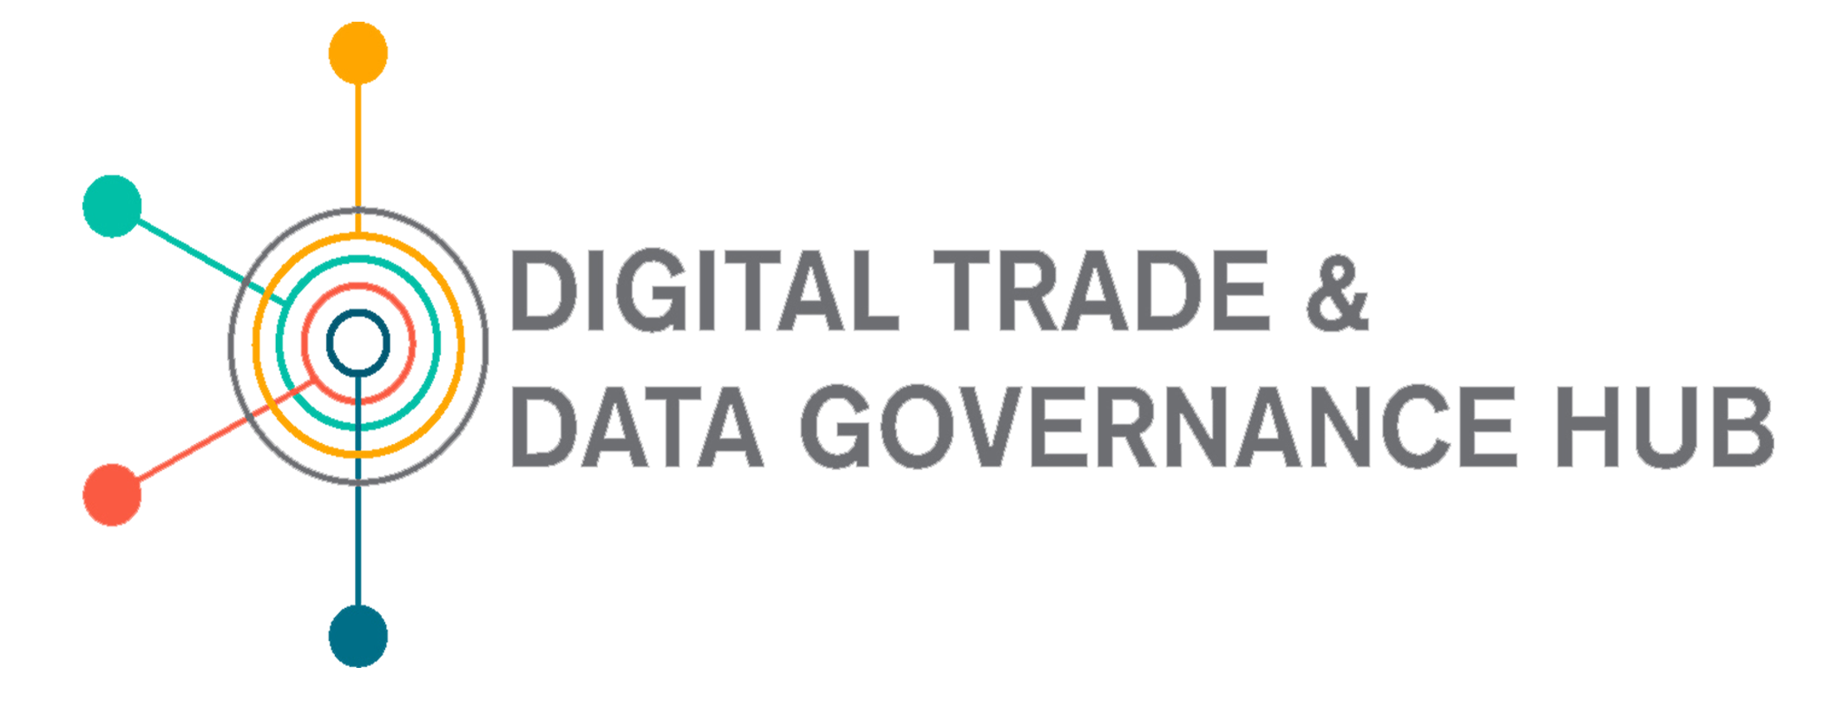
October 1st 2020 17h00 – 18h30
S40: Is the world dividing into data realms and what does it mean for the nations outside the realms?

Slide 2
Susan Aaronson
October 1st 2020 17h00 – 18h30
George Washington University
Organizer
New Ideas for Digital Trade

Slide 3

Background: An Update on Data Realms
All nations are learning how to govern various types of data to facilitate economic growth (nations are most advanced on personal and proprietary data)
Large domestic population (China) plus trade agreements give US, EU, China economies of scale and scope for data, leverage to prod other nations to follow their approach to governing data.
Good data governance allows firms, individuals, governments to utilize a large supply of data, ensure data quality and veracity.
Update on US, US has lost its way.
This Photo by Unknown Author is licensed under CC BY-SA

Slide 4
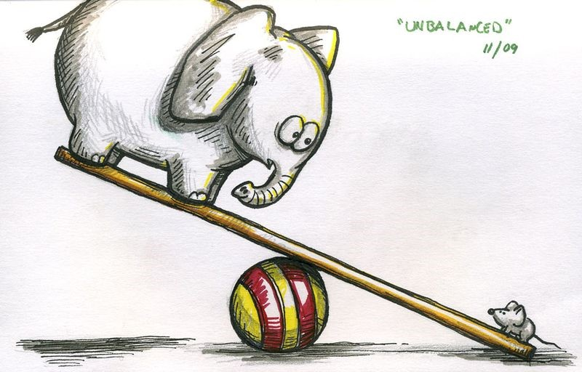
Data realms benefit from information asymmetries
Firms with more computing power better positioned to extract and use data
Firms with more data and money better positioned to exploit big data sets.
However, value is likely to accrue to the owners of scarce data, to players that aggregate data in new ways, and especially to providers of valuable data analytics.
More data: more possible goods and services, which generate more data and more market power
Also applies across countries. Data-driven firms are concentrated in middle-income and wealthy countries.
Countries without data-driven firms struggle to figure out how best to govern various types of data.
This Photo by Unknown Author is licensed under CC BY-NC-ND

Slide 5
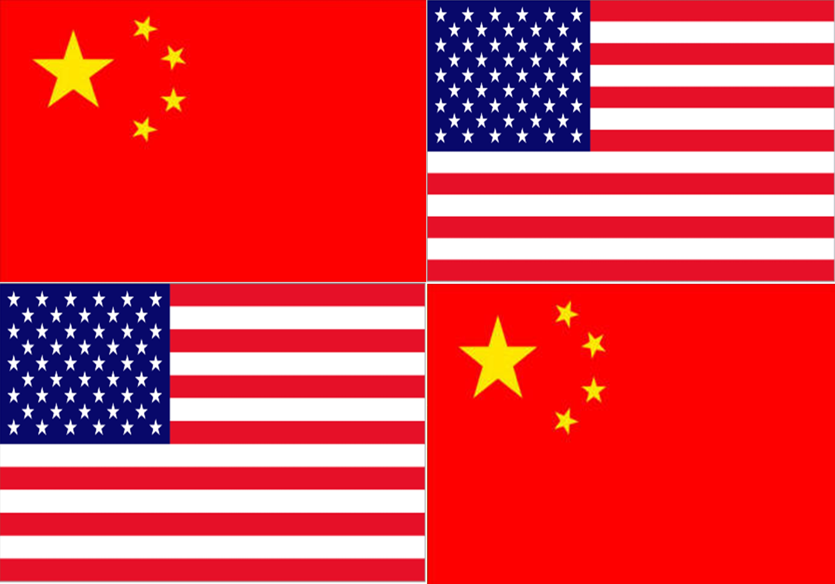
Information asymmetries and absolute advantage
US and Chinese firms collectively hold 75% of all patents related to blockchain technologies; 50% of all spending on the internet of things; 75% of cloud capacity, and 90 per cent of the market capitalization value of the world’s 70 largest digital platforms. (UNCTAD: 2019)
.
This Photo by Unknown Author is licensed under CC BY-SA
Notes:
Absolute Advantage describes the ability of a specific country to produce goods at a lower cost per unit whereas comparative advantage describes the ability of a specific country to produce goods at a lower opportunity cost.

Slide 6
Countries compete for data and the governance of various types of data → 3 data realms
EU has a growing # of trade agreements with binding provisions on cross-border data, most recent EU/Japan. Requires countries that want to exchange personal data to become “adequate” in their protection of personal data. Also EU-common data space for public data. Must be open machine readable. Focus on trust. More than 12 countries have built on GDPR, EU online data protection.
US calls for open data and free flow of data, but is increasingly restrictive of data (net neutrality, content moderation etc.) Less credible on soft power, no federal law governing online personal data. Others are not following US model.
China –Great Firewall may have helped create huge firms with economies of scale and scope re. data, but quality of data is questionable. Data protection building on GDPR. Use Belt and Road to build support/clients for Chinese data firms.

Slide 7
Implications: How nations govern data can affect . . .
Data veracity
Supply of data
Trust in data
Trust in data is key
to maintaining markets
Trust in data
Growing consumption data-driven services
Comparative advantage data governance

Slide 8
As others discussed, data has become national security issue
But data-driven technologies are public goods and we all would be better off if data-driven innovation were global and not pursued as national.
Incentives for global cooperation on innovation and governance are off.

Slide 9

US as case study
USG argued that Tiktok/WeChat is a national security threat. Under 2018 Defense Authorization Act reviewed purchase of Tiktok. US response: Tiktok/WeChat must sell Us operation.
Trump allows a donor company to buy US operations (Oracle).Meanwhile, US judge halts ban on WeChat noting first amendment problems.

Slide 10
Trump Administration perspective
China's big platforms grew up under great firewall, where they were protected and nurtured. These firms now compete effectively in relatively more open markets such as EU Canada, , UK and the US. "Unfair competition."
China is good at stealing, buying legally, buying firms, and creating apps that acquire personal data.
China can use that data, cross data sets and gain new insights into behavior of Americans creating a national security threat. Also, China is great at using AI to attract consumers, provide new services. These new services often attract young people--and they can learn about how these people behave and consume-- metadata is a national security issue.

Slide 11
US response undermines its data realm
America’s longstanding commitment to rule of law, predictability, and openness.
US is becoming more like China in face of national security threat of data.
US is contradicting its longstanding position at WTO as leading advocate of open internet and free flow of data (with clear exceptions).
If US wants to expand its data realm, it should behave “more like us.” Recommit to rule of law, predictability, and openness

Slide 12
Thank you

